Slide 1




PREDICTING NFL GAME OUTCOMES USING MACHINE LEARNING
GROUP MEMBERs：
  Anthony Rizzuto
  Changye Chen
  Daniel Caracitas
  Yuxi Huang
  Zhangrui Luo
  SYS 642-A Data Exploration and Informatics for Engineering Management in Fall 2025
  Instructor: Assistant Professor Sang Won Bae
  Date：2025.11.30
  We pledge our honor that we have abided by the Stevens Honor System

Slide 2
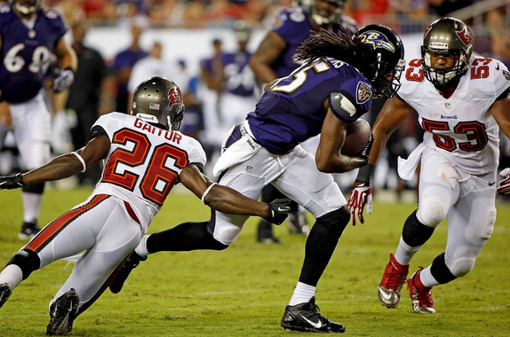

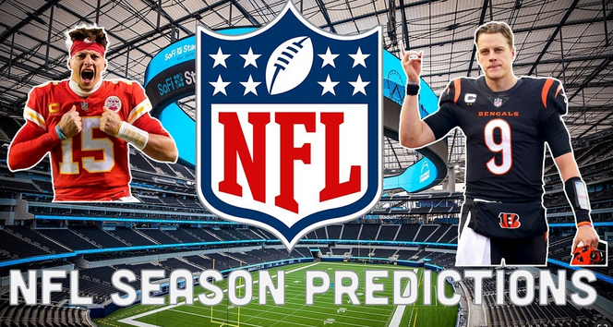
MOTIVATIONS
BACKGROUND &
The NFL is one of the most
popular sports in the U.S. today，the NFL is a multi dollar league.
generates over $18 billion in annual revenue, and each team operates under a salary cap of $255
million
According to the league’s official play-by-play archives, 2009 to 2018, the league recorded more than 350k structured play-by-play events
giving machine-learning models the resolution needed to quantify competitive value before kickoff.
Rich play-by-play datasets
create the perfect setup for machine learning:a high-stakes sport, measurable business impact,
a decade of detailed game data ready for feature engineering

Slide 3
#
BUSINESS UNDERSTANDING
  Develop a predictive model to fore
Stakeholders
Support decision-making for stakeholders
Stakeholders
  Coaching staff ， scouting departments
  Team analysts & strategy groups
  rely on form of pre-game expectation to maatchup strength
Business Question
Can we build a model that predicts the probability that the home team wins a game?
can this pre-game signal be strong enough to support real decision-making?
Why it matters
  Supports pre-game decision making (expectations, game plans).
  Provides probabilistic win chances instead of only descriptive stats.
Offers a framework that can be extended to live in-game win-probability models.

Slide 4

#
PROJECT GOALS
  Develop a predictive model to forecast NFL game outcomes (Win/Loss).
  Provide data-driven insights that support decision-making for multiple stakeholders.
Support decision-making for stakeholders
  Coaches/teams: adjust strategies improve performance before games
  Media/analysts: deliver more accurate predictions and commentary.
  Fans: enjoy deeper engagement and enhanced viewing experience.

Slide 5

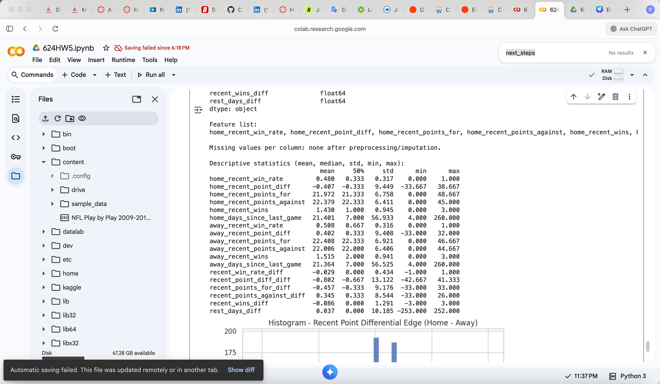
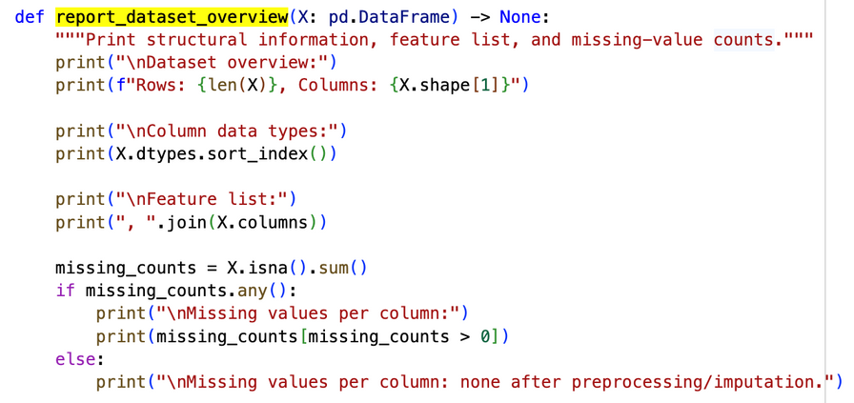
#
NFL Game Data: Scores & Plays (2009-2018)
DATASET DESCRIPTION
Key Variables:
Season, Week, GameStatus, Day, Date, AwayTeam, AwayRecord, AwayScore, AwayWin, HomeTeam...game level
Source Links:
https://www.kaggle.com/datasets/maxhorowitz/nflplaybyplay2009to2016/code

Slide 6
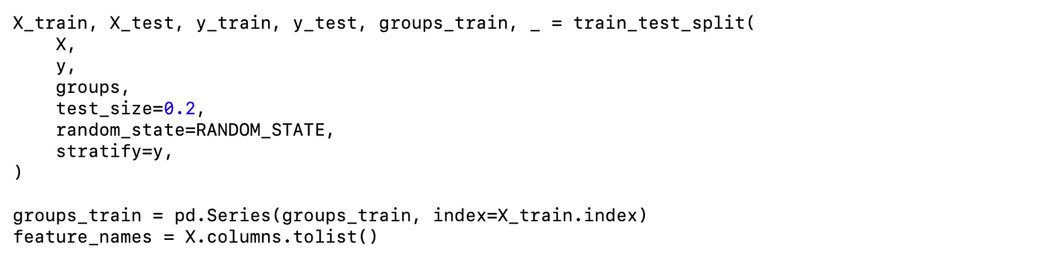
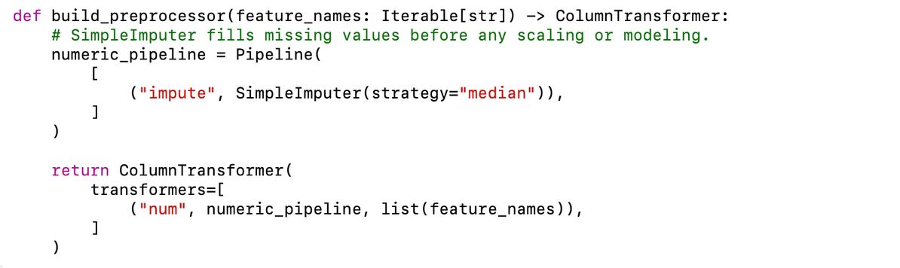
Data Preparation
Missing Values
  Use SimpleImputer(strategy="median") inside a numeric pipeline.
  All features are numeric; no categorical encoding is needed at this stage.
Train/Test Split
  Use train_test_split with:
    test_size = 0.2
    stratify = y to preserve class balance
    groups = home team for later LOSO CV
Preprocessing with ColumnTransformer
  Wrap imputation in a ColumnTransformer ("prep" step).
Scaling Strategies (compared later):
  No scaler (None)
  StandardScaler
  MinMaxScaler

Slide 7
Feature Engineering: Recent Team Form
CLASSIFICATION PROBLEM
Predict if the home team will win in a certain game (home win = 1 or 0).
PREDICTORS
We engineered game-level features from prior games, including:
  Recent win rate of each team
  Recent average point difference
  Recent scoring performance (points for/against)
  Total recent wins
  Days since last game
We then computed the difference between home and away teams on each of these metrics to capture matchup strength.
IMPORTANCE
ALLOWS TEAMS TO OPTIMIZE play-calling decisions and evaluate performance, turning raw game data into strategic insights.

Slide 8

Matchup FeATURES & FINAL FEATURE SET
AFTER COMPUTING TEAM-LEVEL RECENT FORM, WE MERGED HOME AND AWAY RECENT STATS BACK INTO THE GAME TABLE.
  CREATE DIFFERENCE-BASED FEATURES FOR THE MATCHUP:
    RECENT_WIN_RATE_DIFF = HOME_RECENT_WIN_RATE – AWAY_RECENT_WIN_RATE
    RECENT_POINT_DIFF_DIFF
    RECENT_POINTS_FOR_DIFF
    RECENT_POINTS_AGAINST_DIFF
    RECENT_WINS_DIFF
    REST_DAYS_DIFF = HOME_DAYS_SINCE_LAST_GAME – AWAY_DAYS_SINCE_LAST_GAME
ALL ENGINEERED NUMERIC COLUMNS ARE FILLED WITH 0 TO ENSURE NO MISSING VALUES IN THE MODEL INPUT.
  FINAL FEATURE SET:
    ALL NUMERIC ENGINEERED FEATURES EXCEPT IDENTIFIERS AND LEAKAGE FIELDS:
    EXCLUDE: GAME_ID, GAME_DATE, HOME_TEAM, AWAY_TEAM, HOME_POINTS, AWAY_POINTS, HOME_WIN.

Slide 9
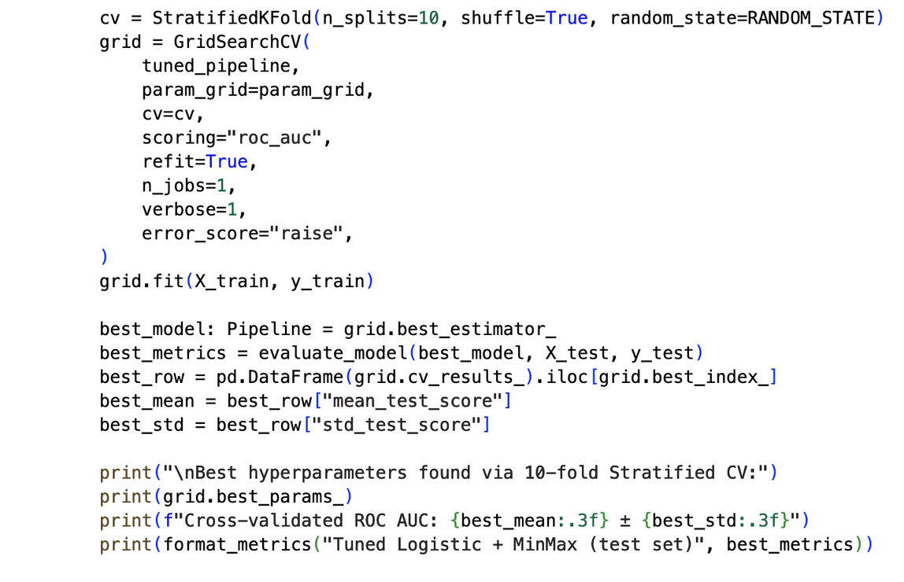
Modeling Setup & Cross-Validation
We built game-level features from the NFL dataset, including indicators like recent win rates and rest days.
After cleaning and splitting the data, we tested multiple models—Logistic Regression, Random Forest, Gradient Boosting, SVC, KNN, and XGBoost—using pipelines with and without scaling.
We evaluated each with 10-fold cross-validation, accuracy, confusion matrix, and ROC-AUC metrics, then visualized the top model’s performance and summarized results in a ranked table.

Slide 10
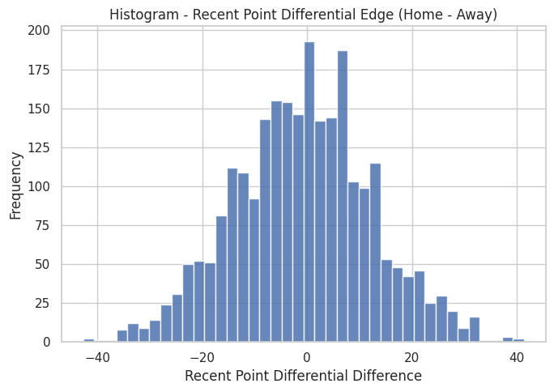
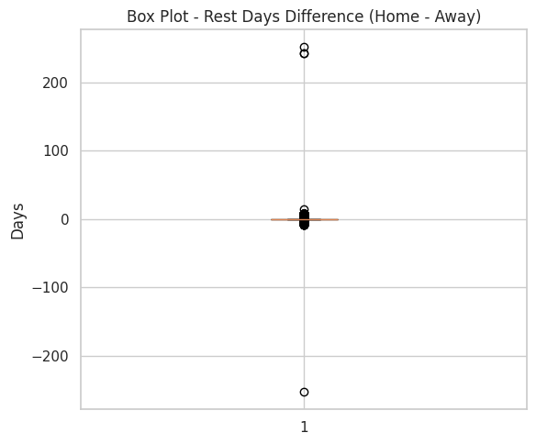
EXPLORATORY DATA ANALYSIS (EDA)
  Shows distribution of recent point differential edges
  Interpretation: Most games cluster near neutral point diferential; right tail shows strong home momentum in some games.
  Highlights how rest-day advantage is distributed.
  Interpretation: Most values within roughly ±7 days; extreme values indicate scheduling quirks
Support decision-making for stakeholders
Notes:
  EDA confirms that most matchups are relatively balanced, with a few games where the home team has a large recent-form advantage.
  Rest-days differences are usually small but can occasionally create large rest advantages or disadvantages.

Slide 11
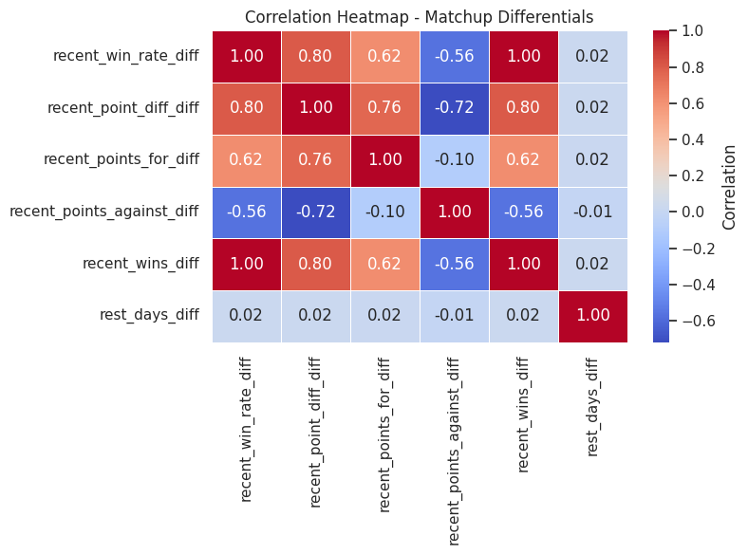
Correlation & Recent Form Patterns
Correlation Heatmap among:
  recent_win_rate_diff
  recent_point_diff_diff
  recent_points_for_diff
  recent_points_against_diff
  recent_wins_diff
  rest_days_diff
Key Observations:
  Win-rate and point-differential edges are positively correlated.
  Rest-days differences are only weakly correlated with performance features.
Scatter Plot: Home vs. away recent win rates
  Points concentrate near diagonal => many games have similar recent form.
  Home wins skew above the diagonal => home winners tend to have slightly stronger recent win rates than their opponents.

Slide 12
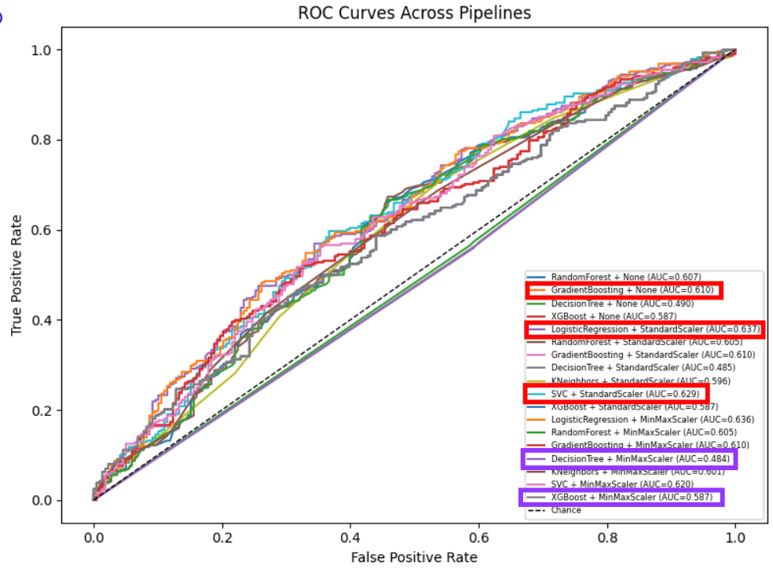
Model Performance
Each curve represents a model and specific scaling technique’s (StandardScaler, MinMax, or None) ability to predict a home team’s game outcome (W/L)
Highest-Performing Models
Logistic Regression - AUC 0.637 (StandardScaler)
SVC - AUC 0.629 (StandardScaler)
Gradient Boosting - AUC = 0.610
Lowest-Performing Models
Decision Tree - AUC = 0.484 (MinMaxScaler)
XG Boost - AUC = 0.587
  Curves that are closer to the top-left region represent stronger-performing models
  AUC values in the 0.6 range represent moderate strength in predictive accuracy
The dashed diagonal line Chance represents random guessing (AUC = 0.5).

Slide 13
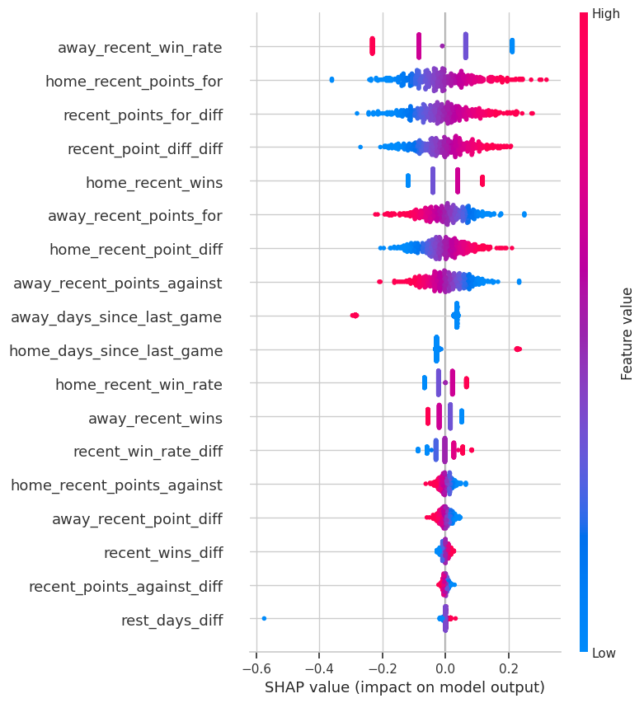
Implications & Contributions
Implications
  The engineered recent-performance features meaningfully influence home win probability.
  SHAP analysis reveals that offensive momentum and scoring trends drive model decisions.
  Away team’s recent win rate and home team’s scoring form are strong predictors of game outcomes.
Contributions
  Provides a fully pre-game, leakage-free modeling framework for NFL outcome prediction.
  Demonstrates how matchup-based feature engineering improves predictive power.
SHAP plot showing the most influential recent-form features in predicting home-team wins.

Slide 14
Conclusion
We successfully built a pre-game NFL win-prediction model using engineered recent-form features
  By avoiding data leakage and using matchup-based metrics, we captured real competitive differences between teams.
  Across all models tested, Logistic Regression with StandardScaler
  Delivered the most stable and reliable performance (AUC ≈ 0.637), highlighting that the strongest signals come from simple, linear differences in recent team form.
  Recent scoring trends, win-rate differences, and point-differential edges consistently emerged as the strongest predictors, while rest-day advantages played a smaller role.

Slide 15
#
References
[1] P. Robberechts, J. Van Haaren, and J. Davis, “Who will win it?
an in-game win probability model for football,” in Proceedings
of the 7th Workshop on Machine Learning and Sports Analytics
(MLSA), 2019, accessed: 2025-11-17. [Online]. Available: https:
//dtai.cs.kuleuven.be/events/MLSA19/papers/robberechts MLSA19.pdf
[2] StatSurge Analytics, “Real-time nfl win prediction with machine
learning,” Online article, 2023, accessed: 2025-11-16. [Online]. Available:
https://statsurge.substack.com/p/real-time-nfl-win-prediction-with
[3] S. Juuri, “Predicting the results of nfl games using machine
learning models,” Master’s Thesis, Aalto University, 2023, accessed:
2025-11-16. [Online]. Available: https://aaltodoc.aalto.fi/bitstreams/
80b6e0d0-f5d1-4c19-abd3-667ee40d9c93/download
[4] AlphaPy Developers, “Sportflow: Machine learning for sports outcome
prediction,” Documentation, 2024, accessed: 2025-11-17. [Online].
Available: https://alphapy.readthedocs.io/en/latest/sportflow.html
[5] V. Satopaa, J. Baron, D. P. Foster, and B. Mellers, “Measuring consensus
in binary forecasts: Nfl game predictions,” Judgment and Decision
Making, vol. 5, no. 6, pp. 437–446, 2010, accessed: 2025-11-17. [Online].
Available: https://www.sas.upenn.edu/∼foster/multipleforecasts.pdf

Slide 16

THANK YOU!

